Slide 1
#120 – Appreciative Inquiry
How to listen to your team to find a new way forward
Jon Lowrance, MSN, CRNA
Producer, Anesthesia Guidebook
Notes:
What’s up yall this Jon Lowrance and this is Anesthesia Guidebook, episode 120 – Appreciative Inquiry.

Slide 2
Anesthesia Guidebook
#117 – Intro to Systems Thinking & High Reliability Oranizations
#118 – Resilience Engineering, Safety Differently & Synesis
#119 – Psychological Safety & Just Culture
Notes:
We just wrapped up a three-part series on systems thinking. I’d highly recommend you go check those out… they covered really good information for today’s healthcare providers and leaders. We talked about the importance of adopting a systems thinking and learning approach to risk and errors, how to proactively build resilience in your group, how to reconceptualize safety as not the absence of errors but the presence of capacity for the right kind of work to take place.

Slide 3
Synesis
How to balance
Productivity
Reliability
Safety
Quality
Hollnagel, E. (2020). Synesis: the unification of productivity, quality, safety and reliability. Routledge.
Notes:
We introduced this idea of synesis, which is how we balance productivity, reliability, safety and quality. I can’t tell you how many times that has come up in the couple of weeks since putting that show out… it’s kind of re-worked how I see the world.
Just yesterday, I was talking with a physician & CRNA on our team about how to get first case on time starts rolling with pre-operative spinals for ortho joint cases. Our team is trying to balance production pressure with patient safety… how do we get the work done on time but in a way that’s safe for the patient. It takes collaboration and teamwork across multiple teams: anesthesia, preop nursing, intraop nursing and more. It’s not straightforward but the work is so important to focus on. We have to be able to generate reliable on time starts but also deliver very high quality, unquestionably safe care.

Slide 4
Psychological Safety
the freedom to speak up without fear of embarrassment or punishment
Edmondson, A. C. (2018). The fearless organization: Creating psychological safety in the workplace for learning, innovation, and growth. John Wiley & Sons.
Notes:
The last episode in the series we just wrapped up was on psychological safety and just culture. Oh man… there’s so much more to say about that. It threads all three shows together and, in a way, tee’s this show up. Psychological safety is critical for leaders to talk about. It doesn’t just happen. It’s about creating an environment where staff are safe to speak up… and students are safe to speak up.
This week, we did an interview with an CRNA candidate from Miami… yes, Miami to Maine! She’s still thinking about the opportunity, but she would be the second CRNA we’ve hired from Miami if she ends up joining our team, which is amazing. But we were talking about psychological safety for trainees and residents. I’ve always thought that clinicians and professors could set a very high bar for excellence in performance for anesthesia trainees but also support their students and trainees to get there. We’ve talked about this for years at Maine Medical Center and that’s the culture we shoot for. Yet only recently I’ve been able to describe this in the terms of psychological safety, which in its essence, is exactly what we were trying to get at with this high expectation-high support culture. Psychological safety is the freedom to speak up and ask a question or ask for help in learning something without fear of embarrassment or punishment. Learners are on a path of learning. That should be understood. They don’t know everything. So they need to be free to speak up and ask questions without fear of punishment or embarrassment. It seems simple enough but far too many organizations have not built a culture of psychological safety.
So those were the last three episodes here on Anesthesia Guidebook.

Slide 5
Appreciative Inquiry
1. Discover what’s working well
2. Dream about what could be
3. Design for future change
4. Look forward to a new destiny
Whitney, D., & Cooperrider, D. (2005). Appreciative inquiry: A positive revolution in change. Berret-Koehler Publishers.
Notes:
Appreciate Inquiry asks people four basic questions:
1. discovery what’s working well
2. dream about what could be
3. design for future change and success
4. look forward to the destiny these changes will bring (Whitney & Cooperrider, 2005)
The idea is to lead change by capitalizing on what’s working well already. You’ll probably uncover some pretty clear opportunities to work on stuff that’s not going well, but framing the whole process – starting the whole process by asking people to talk about what’s working well, sets the tone for positive change. This is not a complain fest. This asks people to weigh what is going well and then to look to the future and what they’d like to see be different.

Slide 6
Appreciative Inquiry
1. Discover what’s working well
2. Dream about what could be
3. Design for future change
4. Look forward to a new destiny
Deliver new results or…
Let the future destiny emerge?
Notes:
That last one’s a little weird… I didn’t like it at first. I actually changed it from destiny to “deliver.” Haha I was trying to stay with the theme of words that started with “D,” but I didn’t really like the idea of destiny. It seemed a little to fluffy & soft. A little too ambiguous and squishy. I figured “deliver needed change or results” sounded better. But what I came to realize is that when a group sets out in an Appreciative Inquiry process, you don’t know where you’re going to end up. You need to listen to your team, let go of your preconceptions about where they’re at and what they need and even have some loose hands about where you’ll end up. The future is not so much something you need to deliver as it is something you and your team or group will move towards together. It’s an unknown factor. It will emerge out of the work you do in the Appreciative Inquiry process. What the future will look like might be different when you move through this process than what you first had imagined… and that’s ok. So it’s more about discovering the destiny you or destination you’ll end up at versus trying to deliver results or outcomes.

Slide 7
Notes:
So, what did we do at Maine Medical Center? Well, last year we took the American Medical Association’s MiniZ survey… any of yall do that? Or some other kind of engagement survey? The MiniZ, which, by the way I have no idea why it’s called the MiniZ. Well, I’ve heard it’s the Mini-Z because it’s not the full-Z survey, which was the original survey. So now we have the Mini cause it’s shorter, but I don’t think anyone knows what the Z is about. Full-Z, Mini-Z, who knows. If you know, let me know.
Any way… one of the things we heard from our team out of that survey – the Mini Z Survey - is that they wanted more opportunity to be heard and weigh in on decisions and have their ideas followed up on. Overall, our CRNA team described pretty high levels of job satisfaction and engagement, which was great, but this one specific area about having more input and having that input taken seriously was a sticking point for me. I wanted to do something about that.

Slide 8
Appreciative Inquiry
1. Discover what’s working well
2. Dream about what could be
3. Design for future change
4. Look forward to a new destiny
Whitney, D., & Cooperrider, D. (2005). Appreciative inquiry: A positive revolution in change. Berret-Koehler Publishers.
Notes:
So we decided to create space for where our team could weigh in more and speak up more and Appreciative Inquiry creates a great avenue for people to do that.
It’s a pretty simple conversation to have with folks. You can literally just have a conversation and you should make this conversational with folks on your team if you get the chance. We ended up packaging this as a survey with our team, which was kind of a bummer because it’s just another survey, right? I think we have too many surveys. And not enough conversations. But it’s hard to have conversations with a big team of people. And not everyone wants to tell you what they really think in person. So sometimes a survey creates a pretty good space for people to speak up… a psychological safe space, if you will, to let your opinions get out there.
So, Appreciative Inquiry has these four basic components:
1. Discover what’s working well
2. Dream about what could be
3. Design for future change
4. Let your future destiny emerge
If you ask these questions, I guarantee you, you’re going to get some great info back. It might be surprising.

Slide 9
CRNA Dream Team Survey
1. How long have you been part of our team?
2. What aspects of our team or our work do you think are going well?
3. Can you share a specific example of a time when our team was at its best?
4. Where can we make the most impactful changes?
5. What are your dreams for the future of our team or the work we do?
6. What changes would you like to see in our team to achieve these dreams?
7. How do you think we can deliver on these needed changes?
8. What role do you see yourself playing in delivering these changes?
9. How confident are you in our team’s ability to implement these changes?
10. Do you have any additional thoughts or suggestions? (If you want to share your name, please do so here.)
Notes:
We went at this basic outline of Appreciative Inquiry with 10 questions in our survey. I know, I know… keep it simple and all that. Maybe we could have just asked the 4 basic questions, but see what you think of these 10 questions. We called it the Dream Team Survey… cause that’s what we want to be. Haha. I’m going to share them with you here in case you want to borrow them. Again, this is all in the show notes or video for this episode so check the website if you want these written down.
1. How long have you been part of our team?
2. What aspects of our team or our work do you think are going well?
3. Can you share a specific example of a time when our team was at its best?
4. Where can we make the most impactful changes?
5. What are your dreams for the future of our team or the work we do?
6. What changes would you like to see in our team to achieve these dreams?
7. How do you think we can deliver on these needed changes?
8. What role do you see yourself playing in delivering these changes?
9. How confident are you in our team’s ability to implement these changes?
10. Do you have any additional thoughts or suggestions? (If you want to share your name, please do so here.)
So out of the 10 questions, 7 of them were open ended and few of those had numerical values the team could pick.
We put the survey out about a month before our most recent staff meeting and we had a pretty good response rate with over 160 comments from a big chunk of our team. We would have loved to see more people take the survey, which is always the case, but we were pretty stoked to get back over a 160 comments. That was a lot of info.

Slide 10
Appreciative Inquiry
1. Discover what’s working well
2. Dream about what could be
3. Design for future change
4. Look forward to a new destiny
Whitney, D., & Cooperrider, D. (2005). Appreciative inquiry: A positive revolution in change. Berret-Koehler Publishers.
Notes:
We then set the staff meeting up as an opportunity to talk further about the core questions:
1. What’s working well?
2. What do you want to see change?
3. What are your dreams for the future?
4. How could we design the way we do things to bring about that future?

Slide 11
Appreciative Inquiry
1. Discover what’s working well
2. Dream about what could be
3. Design for future change
4. Look forward to a new destiny
Notes:
At the staff meeting, I talked about how my understanding of the fourth D changed as I read more about Appreciative Inquiry and this other thing call Theory U, which I’ll tell you about in just a minute. My understanding of the final “D” changed over time. It shifted in just the month the survey was open. I actually sent the survey out by email and talked about it like we were going to “deliver” future results or something like that. But after I sent it out, I continued to think more about the process and why that word destiny was bothering me. I was also reading about this idea of Theory U by Otto Scharmer. Scharmer talks about when you truly engage in a meaningful process of change within an organization, you don’t know fully where you’re going to end up. The future emerges from the process. The destination reveals itself along the way. I began to see the point in Appreciative Inquiry of the word Destiny. So when we got together as a team of CRNAs, I mentioned how my understanding of the process changed and I think it helped me set up a better environment for the conversation. It helped create a more psychologically safe space. I got to say something like, I don’t know where we’ll end up or what the changes are going to look like, but I can promise that we’re going to listen to each other and work together to figure out the next phase of where we’re headed. Appreciative Inquiry is less about knowing where you’re going to end up or having the answers at the start and more about asking better questions: What’s going well already? What do we want to see change? How do we want to get there?
And so we had a great conversation. It was short – too short – at least in my opinion. Most people probably just wanted to get out of there. We actually were already working on feedback we had gotten about our staff meetings and made the one I’m talking about a lot shorter. But we still had a little over an hour to settle into this conversation on what’s going well and what we could do differently.
At this point, we’ve closed the survey out and are getting ready to share all the feedback we’ve had in the survey and in the staff meeting back with the team. We plan to share all the comments out. They’re great. Fortunately, there was nothing in there that need to be super confidential or anything. I think the group can handle seeing what others wrote and we made it clear from the get go that was the intention – to share all the data back with everyone so everyone who was interested had all the comments from the colleagues about what they think is going well and where we could possibly make changes.
The conversation isn’t over; we’re actually still like in the middle of this process with our team but I wanted to talk about it here now… this whole process has actually been part of a graduate course I’m taking on learning organizations in the University of Southern Maine’s PhD program in leadership & organizational development. So the timing of this podcast – and really the last several on systems thinking – have all been tied to some work I’m doing related to school. And like many of you, here at the end of April & start of May, I’m wrapping up an academic semester. So while our team at MaineHealth is still in the process of learning and talking about the changes we’d like to see come about, we get to have this concersation about it now, which is kind of fun. Cause I still don’t know where we’ll end up in terms of our group. We have several threads open that we’re working on… new ways to manage our daily process of letting staff go home, new ways to support staff with training in point of care ultrasound, new ways for the team to get to know one another and connect… there’s so much happening and so many fun things that could come out of this work. Like way beyond just a grad school project, this is pretty exciting stuff and I’m stoked to talk about this here with you today. Maybe you can steal some of this for where you work.

Slide 12
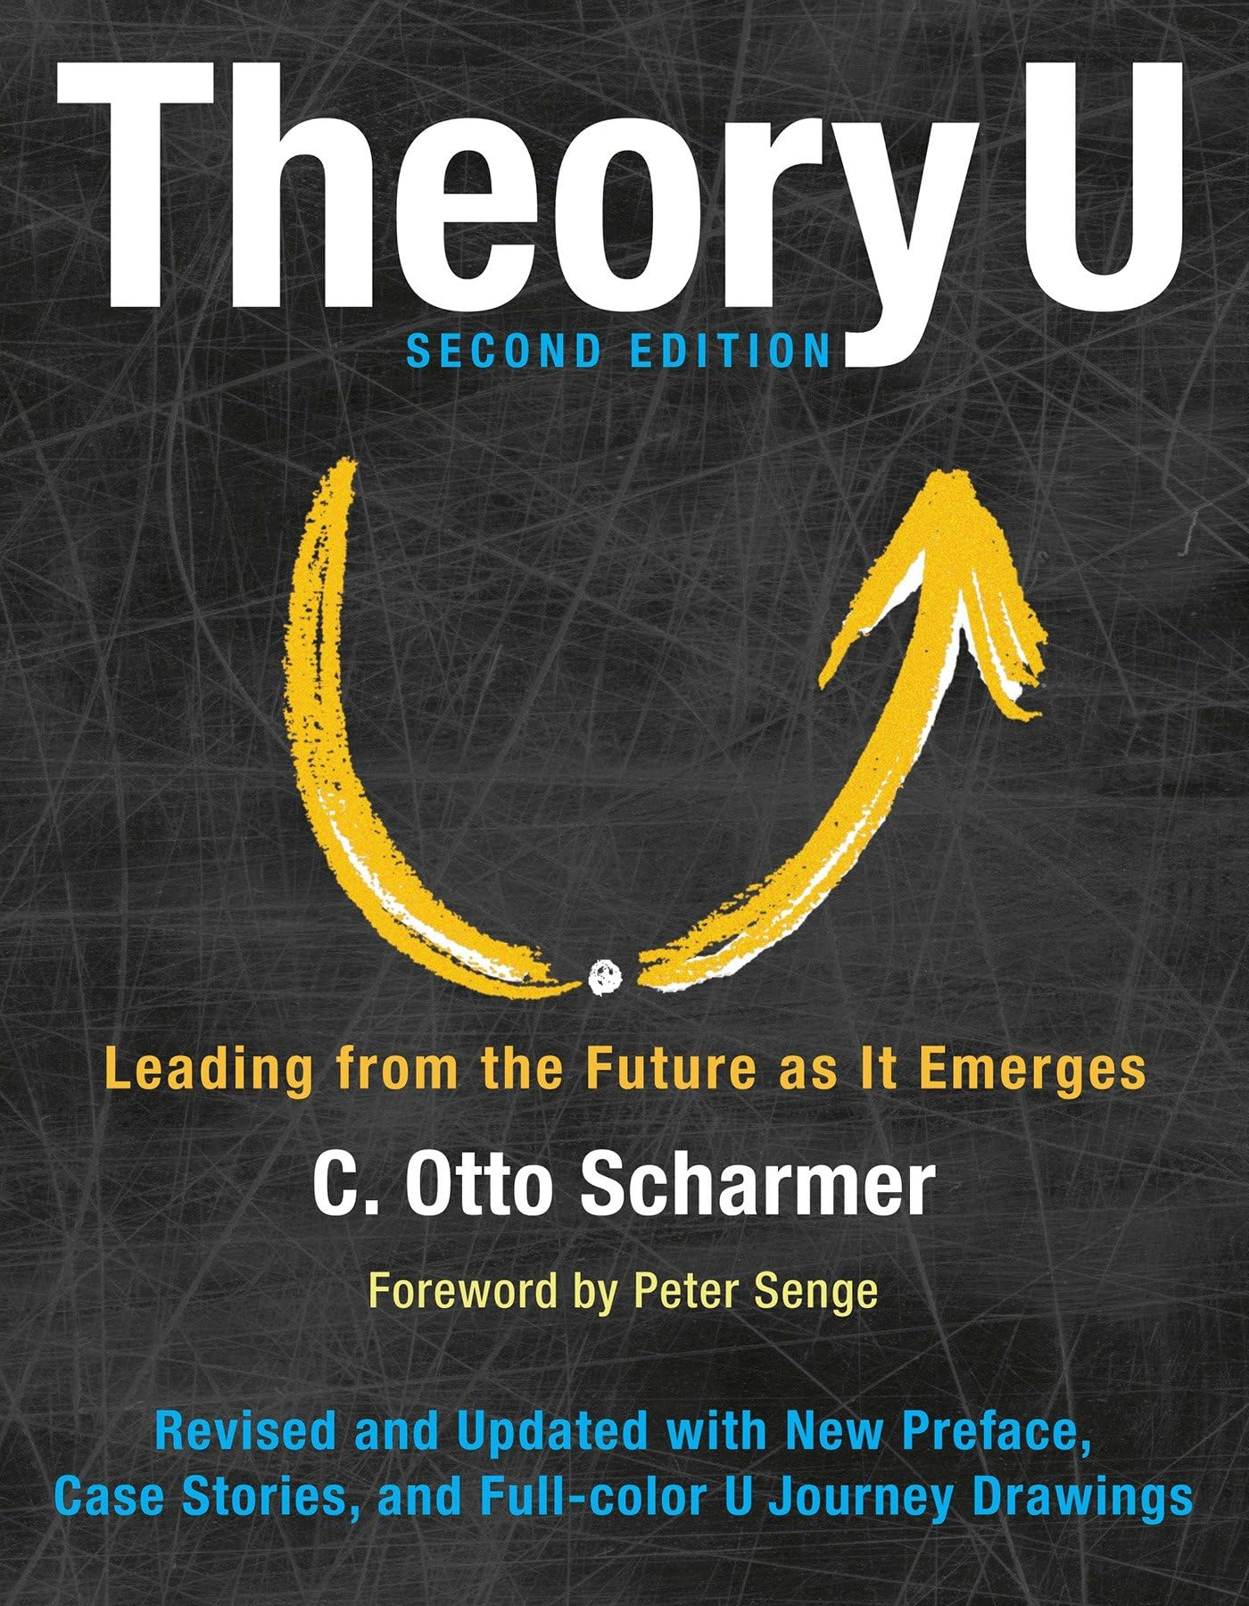
Scharmer, C. O. (2016). Theory U: Leading from the future as it emerges. Berrett-Koehler Publishers.
Notes:
So I want to link this process of Appreciative Inquiry with a pretty impactful systems thinking process that I’ve hinted on throughout this show but haven’t spoken directly about. We’ll close with this.
Otto Scharmer is an organizational thinker who cooked up this idea of the Theory U. It sounds a little wonky at first so hang with me. If you tune in here, you’ll likely walk away with some really good ideas of how to be a better leader and maybe a better colleague, too.

Slide 13
Scharmer, O. (2025). Theory U process of co-sensing and co-creating. Presencing Institute. https://www.presencing.org
Notes:
So Scharmer’s Theory U looks like a big U. It’s spelled with just the letter U – not YOU but just U. Look up Theory U on google or whatever to see the schematic in detail. This is also in the video and show notes of this episode. I’ll walk us through it hopefully in a way that makes sense. Imagine a big ole’ U… downslope on the left, bottom curvy part, upslope on the right. Scharmer lays out a process of change that mirrors Appreciative Inquiry pretty well. Or maybe Appreciative Inquiry layers into the Theory U pretty well. Either way: Scharmer describes the way teams change and evolve by starting on the left side of the U where they download what’s going on, suspend preconceived notions and see the situation with fresh eyes. Appreciate Inquiry gets at this by asking the team to “discover what’s working well.” The downslope of the U continues with the idea of sensing and letting go: can you sense what’s happening in your team, can you let go of old ways of doing things? The bottom of the U is this really interesting idea of presencing with others, yourself or the ideas you’ve been thinking about. Presencing sounds hokey, I totally get that. But it’s this idea of sitting with whatever you’re working on. Just sit with it. Download what’s been going on – get a sense of perspective on your situation, see it with fresh eyes, let go of preconceived notions and take in the feedback or data you receive with an open mind, open heart and open will. And then sit with it. Let your team say what they need to say. Presence with them. Be with them. Listen. Let it come. Whatever it is. Then start to dream about what could be.
We’re on the upslope of the U now. Start to design for future change. Scharmer talks about creating a vision and intention for a future state. Get clear about your goals – about the process, your values, how you’ll go about the change. Seth Godin defines culture as “people like us do things like this.” How will your team build what they want to see. Then start to enact the change you want to see. Scharmer says this is a co-creation process. That also sounds hokey at first. But it’s kind of nice. The pressure isn’t all on you as an individual staff person or a leader. It’s a co-creation process. It’s not about you delivering results, right? The team co-creates its future. You can delegate. Others can collaborate. We share the work of creating the future we want to see. Scharmer tops off the right side of the U, the upslope of the U, with prototyping the new change, embodying the change and then performing. Find the new. Let it emerge from the process. It might look different than what you had imagined. This is the destiny part of Appreciative Inquiry. Let the group arrive at a new destiny versus trying to control the outcome.

Slide 14
Find Your Dream Team
Appreciative Inquiry
Theory U
Discover what’s working well
Dream what could be
Design for future change
Let the destiny emerge
Co-initiate change
Sense what’s going on
Presence / sit with it
Co-create the future
Evolve new practices
Whitney, D., & Cooperrider, D. (2005). Appreciative inquiry: A positive revolution in change. Berret-Koehler Publishers.
Scharmer, C. O. (2016). Theory U: Leading from the future as it emerges. Berrett-Koehler Publishers.
Notes:
So there you go… Appreciative Inquiry and Theory U. Again, Appreciative Inquiry asks four basic questions:
1. discover what’s working well
2. dream about what could be
3. design for future change
4. let your future destiny emerge from the process
Scharmer describes this process in terms of systems thinking and group dynamics in his Theory U:
Download what’s been working & not working
See it with fresh eyes
Get a sense of what’s going on.
Let go of preconceived notions and old ways of doing things.
Presence with your team, yourself, your ideas and the potential future. Sit with it. Be present with it.
Then let that future come.
Start designing for future change.
Crystallize your vision & intention and then enact the change you’ve planned
Prototype new ways of doing things. Trial it. Try it out. Do a pilot. See if it fits. If it doesn’t change it. Start over.
If it works, start to embody the new change. People like us do things like this.
Then get out there and crush it. Perform. Haha

Slide 15
#120 – Appreciative Inquiry
How to listen to your team to find a new way forward
Jon Lowrance, MSN, CRNA
Producer, Anesthesia Guidebook
Notes:
I think big lessons from the process we’ve worked through with our team is that folks want to be heard. And they don’t just want to be heard but they want to see change come. It’s so frustrating to bring up issues over and over again and not see anything change. The follow through is key. Don’t just create space for people to speak up. Seal the deal by following through and working to bring about needed change. And don’t try to control the whole process. You may not know where a certain thing will end up. That’s ok. Maybe it’s a way yall do your schedule. Or determine specialty teams. Or structure committees. Or hold staff meetings. Chances are, you could do any one of those things better. Maybe you could do all of them better. Have you ever asked your team about what they think?
Maybe you’re not in a formal leadership position – you’re still a leader by the way, because leadership is not about having a formal leadership position but rather just influencing others. But maybe you’re not in a position of authority or leadership or administration or whatever and you want to see things change. Have you asked your boss or supervisor if you could change something or if they could change something?
I think as I look back on the process we’ve entered into at Maine Medical Center, the thing I wish we could do more of is presence with each other. Is find time to talk and listen. To sit with staff and hear get their input. We do annual performance evaluations, which for me, are really just check-ins with the staff to find out how I can support them better. I’m happy to give feedback or evaluate performance but most of the time, our staff is out there crushing it every day and our little check in’s are just check in’s. It’s a time to find out what they need to be able to do their work better and easier. But annually is not enough. I talk to a lot of people probably every week. But I only really catch up with everyone far more sporadically. So that’s something I’d like to change in my personal leadership journey moving forward. I’d like to prioritize checking in with the team more often.
How about you? What are you hoping to do more of or less of? Did any of this help? I hope so!
Take a look at Appreciative Inquiry. I think you’ll like it. It’s a pretty fun conversation to have with your team. If you want to dig a little deeper into the organizational leadership & development thing, Scharmer’s one of your guys. There’s a lot of wisdom in the Theory U – much of it we didn’t even get into here for sake of time. But hopefully these things will give you some stuff to work with.
I’m stoked about the work yall are doing. It’s a great time to be in healthcare. Change is happening everywhere and those who are ready for it and who are adaptable are going to do great things… and I think that’s probably you, cause you made it to the end of this show so you must either be crazy or highly motivated. Maybe both. Why else would you be here listening to me ramble on? Haha. Enjoy the process. Please don’t hesitate to reach out if I can be helpful to you. I always love hearing from folks who’ve found the podcast. Take care of yourself and I’ll see you next time!

Slide 16
References
Edmondson, A. C. (2018). The fearless organization: Creating psychological safety in the workplace for learning, innovation, and growth. John Wiley & Sons.
Hollnagel, E. (2020). Synesis: the unification of productivity, quality, safety and reliability. Routledge.
Scharmer, O. (2016). Theory U: Leading from the future as it emerges. Berrett-Koehler Publishers.
Scharmer, O. (2025). Theory U process of co-sensing and co-creating. Presencing Institute. https://www.presencing.org
Whitney, D., & Cooperrider, D. (2005). Appreciative inquiry: A positive revolution in change. Berret-Koehler Publishers.

